Slide 1
Data Analysis for Derby County F.C.
Edward Webster
September 2020

Slide 2
Contents
Background slides:
About this presentation pack
Task brief
Workflow and tools:
Workflow and tools used for this data analysis
Flow chart
Metrics used in analysis
Position metrics
Tools used
Data analysis slides:
Player profiles – Jayden Bogle and Tom Lawrence
Derby County team profile
Scouted players (1-4 per position)
Conclusion and next steps
Appendix

Slide 3
The aim of this presentation pack:
To used data analysis as the starting point to identify replacements for two Derby County players –
Jayden Bogle and Tom Lawrence

Slide 4
Task Brief
Identify potential replacements for two Derby County players - Jayden Bogle and Tom Lawrence, using data analysis.
Suggest ~3 target replacements for each of the two players.
At least one of your recommendations for each position should be a player aged 23 or younger.
Due to budgetary restrictions, you should also recommend at least one player from a division lower than the Championship.
Important considerations when providing recommendations:
The attainability of any potential targets given the club's budget and standing;
Whether a potential recruit may be undervalued;
Whether a potential recruit would fit with Derby's playing style;
How far you expect a young player's performances to improve as they gain experience; and
How a player's performance might translate from League One or League Two up to the Championship.

Slide 5


Workflow and Tools
Programming languages and visualisation tools used in this sample project
For the data preparation (backend), the data has been acquired (scraped) using Python and then engineered using Python in a Jupyter notebooks environment.
The frontend tools created from the data are built using Tableau. The reason why I chose to use Tableau to visualise the data is due to the products functionality and ease-of-use to those at all levels of the football club, including coaching staff and players. Tableau dashboards can be published and accessed on iPads and mobile devices, enabling use by the coaches and players on the training field, the changing room, or at home. For data analysis to be effective, it needs to be a part of the holistic approach of the club and be accessible not just to power users such as Data Analysts and Data Scientists, but to everyone at every level of the club. In my opinion, Tableau is the best tool for this.
If Tableau is not available as a product to the club, the data can be visualised using PowerBI or a number of Python packages including matplotlib, Seaborn, or Plotly, to name but a few (examples of different visualisation projects are available in my GitHub repo).

Slide 6
Workflow Flow Chart
Data Acquisition and Parsing
Data Engineering
Data from TransferMarkt is scraped using Python webscrapers.
Data Visualisation and Analysis
Scraped data from TransferMarkt is cleaned and engineered using the pandas Python library in Jupyter notebooks.
Data visualised in Jupyter notebooks, as dashboards using Tableau, and as figures in PowerPoint slides.
Dashboards published to Tableau Public.
Fuzzy data matching of the two data sources from 21st Club and TransferMarkt enables creation of new analysis of Stats per £ metrics.
Key observations and comments of the data analysis includes in PowerPoint figures.
Data from 21st Club is provided in the email as a CSV file.
Data from 21st Club is engineered to create new KPIs and attributes derived from the raw data to create tailor-made metrics for the coaches and data teams. The combined DataFrame is also melted as a long table as this was required when building the Tableau radar visualisations.

Slide 7
Metric used in Analysis
Different metrics selected for the each player’s varying position
Depending on the position, different metrics are required to assess a player’s performance. These metrics are explained both for full-backs and wingers in more detail, in the following two slides.
Metrics that might be deemed a good measure of performance for an attacking player, such as goals and assists, may not be as well-suited for defensive players that contribute in other aspects such as tackles and aerial duels.
Metrics were also required to be standardised so that players that have played a full season can be compared to those that may have not played a full season. For example, players that joined in the January transfer window, players that are/have been injured, or young players who may drift in and out of the squad. For this, a per 90 metric was created, to standardised statistics per time played.
The metrics provided in the dataset have also been used to derive new, aggregated metrics. Examples of these metrics include Deep Progressions, which is a summation of a player’s passes, dribbles, and carries into the box. Depending on the player type, he may be a crosser such as David Beckham, or a dribbler such as Lionel Messi, or an incisive passer such as David Silva, to name but a few, broad examples. These metrics hope to provide a way to compare players that all may be effective, but in different ways.
Full list of all metrics from the original data source can be found in the appendix.

Slide 8
Full-Back Metrics
Metrics chosen to best analyse a full-back’s abilities
Tackles p90 = Tackles per 90 minutes (where p90 is a calculated field of Play Time / 90)
Interceptions p90 = Interceptions per 90 minutes
Recoveries p90 = Recoveries per 90 minutes
Deep Progressions p90 = (Pass Op Box + Dribbles Box + Carries Box) per 90 minutes
Blocks p90 = Blocks per 90 minutes
Carries p90 = Carries per 90 minutes
Passing OP % = (Pass OP Box Successful + Pass OP Final Third Successful + Pass OP Head Successful) ÷ (Pass OP Box + Pass OP Final Third + Pass OP Head)
Dribbles % = Dribbles Successful ÷ Dribbles
Launches % = Launches Successful / Launches
Aerial Duels % = (Aerial Duels Att Won + Aerial Duels Def Won) ÷ (Aerial Duels Att + Aerial Duels Def)
Ground Duels % = (Ground Duels Att Won + Ground Duels Def Won) ÷ (Ground Duels Att + Ground Duels Def)
Crosses OP % = Crosses OP Successful ÷ (Crosses OP Left + Crosses OP Right)

Slide 9
Winger Metrics
Metrics chosen to best analyse a winger’s abilities
Shots per Goal = Shots + Goals
Goals p90 = Goals per 90 minutes (where p90 is a calculated field of Play Time / 90)
Shots p90 = Shots per 90 minutes
Assists p90 = (Pass Op Box + Dribbles Box + Carries Box) per 90 minutes
Interceptions p90 = Interceptions per 90 minutes
Deep Progressions p90 = (Pass Op Box + Dribbles Box + Carries Box) per 90 minutes
Carry Distance p90 = Carry Distance per 90 minutes
Carries Box p90 = Carries in the Box per 90 minutes
Dribbles % = Dribbles Successful ÷ Dribbles
Crosses OP % = Crosses OP Successful ÷ (Crosses OP Left + Crosses OP Right)
Passing OP % = (Pass OP Box Successful + Pass OP Final Third Successful + Pass OP Head Successful) ÷ (Pass OP Box + Pass OP Final Third + Pass OP Head)
Passing OP Box % = Pass OP Box Successful ÷ Pass OP Box

Slide 10
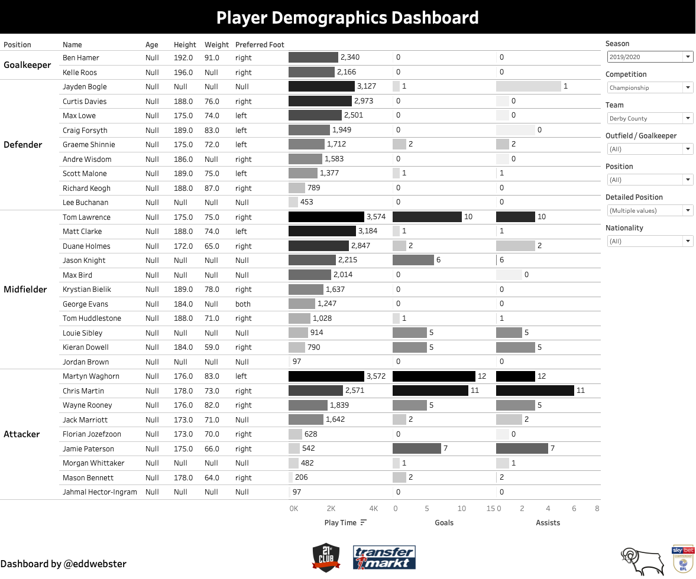
Tool 1: Player Demographics
Simple bar charts the deliver key player information quickly and concisely
The Player Demographics dashboard is a simple dashboard of bar charts, that splits players into their positions – goalkeeper, defender, midfielder, and forward.
The bars show key statistics for each players including: the minutes played, number of appearances, goals, and assists.
The purpose of this dashboard is to quickly gauge how valuable certain players are to a team, such as Derby and answer basic question quickly such as player that make up the first XI.
In this dashboard, we can see that regarding minutes played, both Bogle and Lawrence are the most featured players for the 2019/20 campaign for their respective positions, and are key players for the club.
Potential data sources that would add additional value if included in this dashboard:
No. substitute appearances (on and off); and
Percentage of time.
Player performance data provided by 21st Club and estimated market value data provided by TransferMarkt

Slide 11
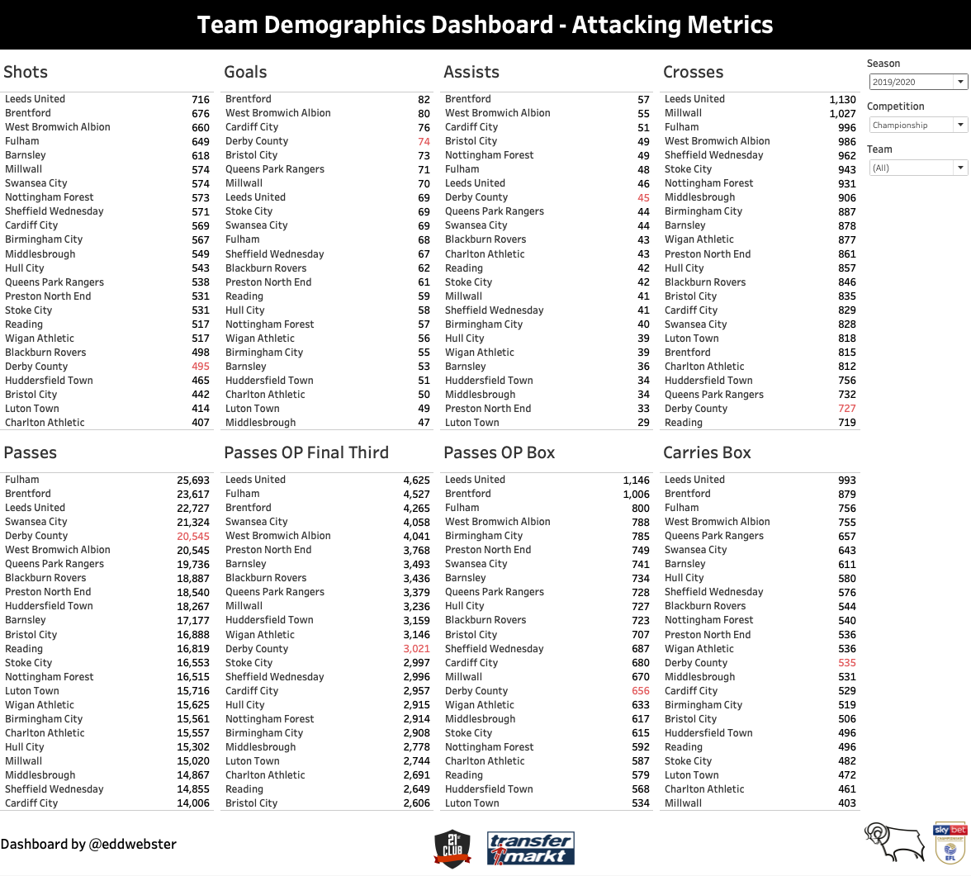
Tool 2: Team Demographics Dashboard
Interactive visualisation of per positions metrics
A dashboard of simple bar charts that show the key metrics of teams.
Selecting a team in one of the metrics highlights that same team in the other metrics.
The metrics have been split across two dashboards – attack and defensive metrics.
Dashboards can be filtered by:
Season;
Competition; and
Team.
The purpose of this dashboard is to quickly gauge an idea of a team’s playing style and the aspects of the game in which they excel/do less well compared to other teams.
In this attacking metrics table, we can suggest that Derby County are a possession-based (5th/24 for passes) and a high scoring team (4th) for who take relative few shots (20th). These statistics suggests Derby are efficient at taking their chances. They are averagely ranked for Open Play Passes into the Final Third and Box, and Carries into the Box, and cross the ball very little (23rd for crosses), which suggests that their build-up play is very patient and they prefer to have players who are happy to have the ball.
Metrics that could be used to improve the performance of this radar with additional Event data:
‘Expected’ metrics: Expected Goals (xG), Expected Assists (xA), xGBuildup, and Expected Threat (xT),
Team possession
Team performance data provided by 21st Club.

Slide 12
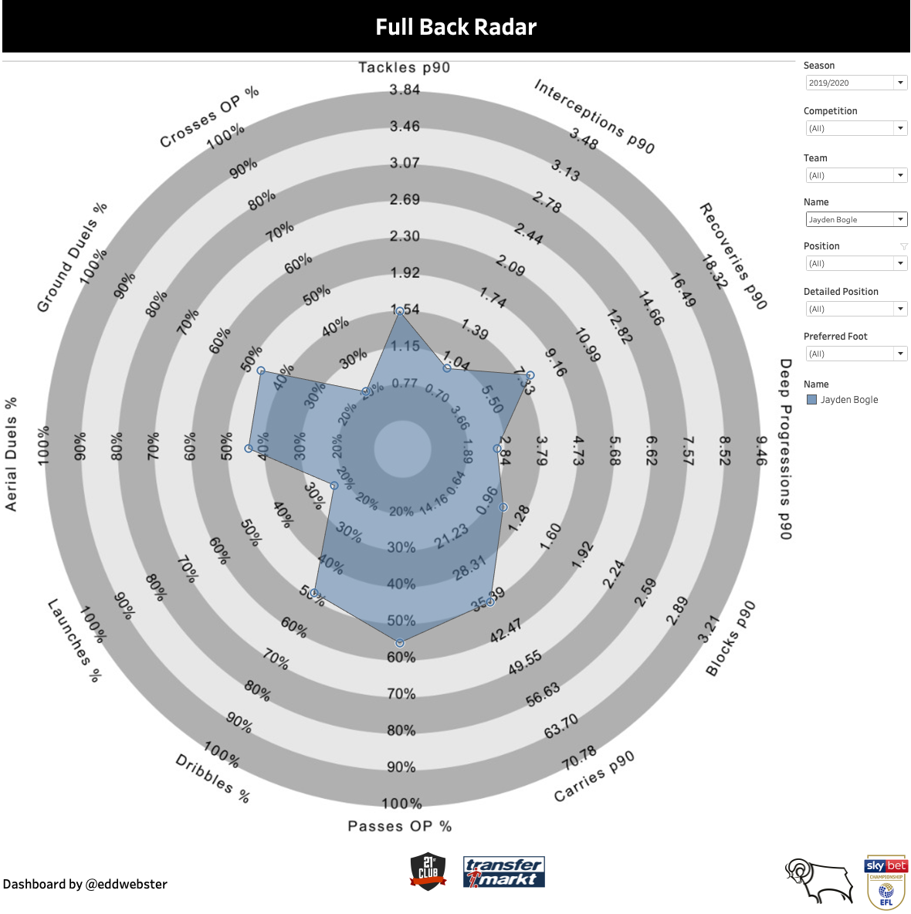
Tool 3: Radar Dashboards
Interactive visualisation of players per positions metrics
Interactive Player Radars dashboards designed to show a number of key, position-specific metrics, in a visually appealing way.
Data can be filtered by:
Season;
Competition;
Estimated Player Value;
Preferred Foot;
Age;
Minutes Played; and
Goals Scored.
Bespoke radars created per position to assess the metrics of the most important KPIs for different roles in the team.
Metrics calibrated per 90 minutes to standardised so that players that have played a full season can be compared with those that may not have, for whatever reason.
Metrics that could be used to improve the performance of this radar with additional Event data:
Expected Goals (xG);
Expected Assists (xA);
xGBuildup;
Expected Threat (xT);
Turnovers (how often a player loses the ball via a miscontrol or a failed dribble per 90 minutes);
Possession Adjusted (PAdj) metrics to recalibrate metrics based on a team’s possession;
Fouls; and
Tackles verse Dribbles Past.
Team performance data provided by 21st Club.

Slide 13
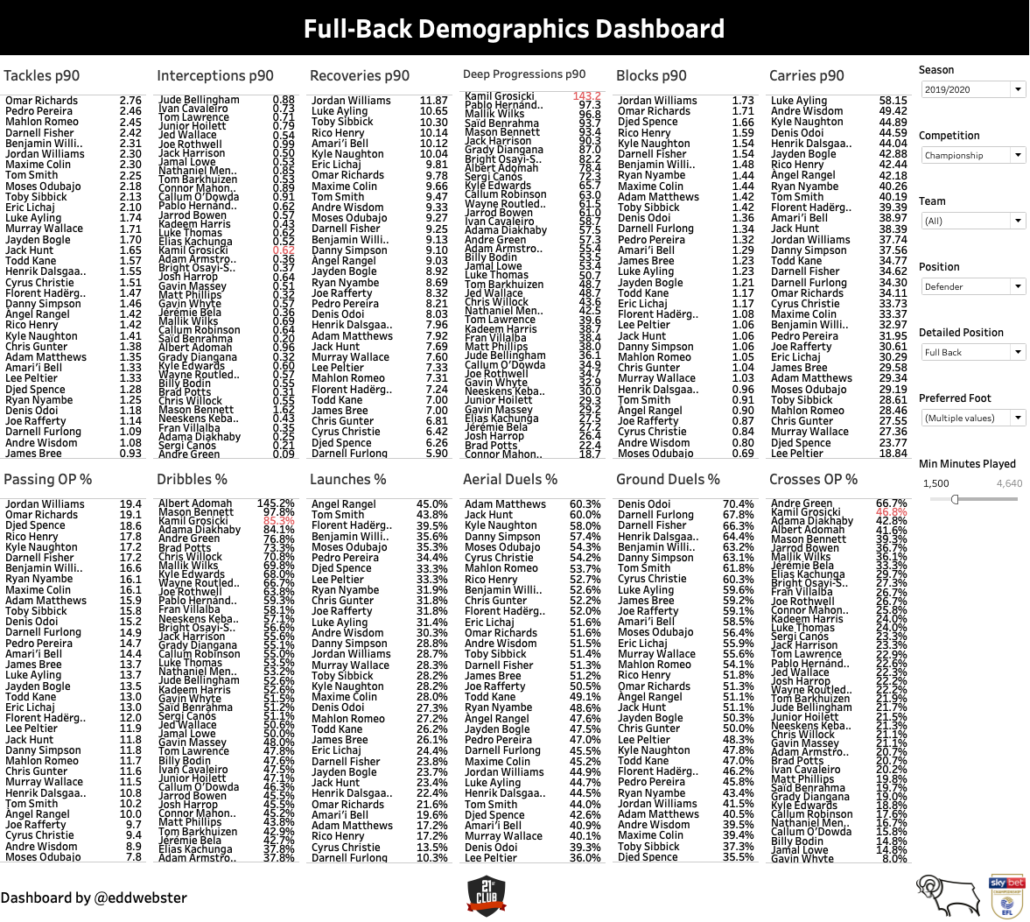
Tool 4: Ranking of Players by Metrics per Position
Further breakdown of the selected metrics per position to rank players
This simple Ranking of Players per Metric dashboard shows the key metrics per player position.
In this example for full-backs, the dashboard shows the ranking of the players for the Championship 2019/20 season as per twelve, selected metrics, deemed to be of most importance for that position. These metrics include: Tackles per 90, Interceptions per 90, Recoveries per 90, Deep Progressions per 90, Blocks per 90, Carries per 90, Passes in Open Play Success %, Dribbles Success %, Launches Success %, Aerial Duels Success %, Ground Duels Success %, Crosses Open Play Success %.
In real world scouting, these metrics would be agreed upon between the the coaches and manager, and put into action by the data analysts, to ensure that players are asses for the right playing style.
Team performance data provided by 21st Club.

Slide 14
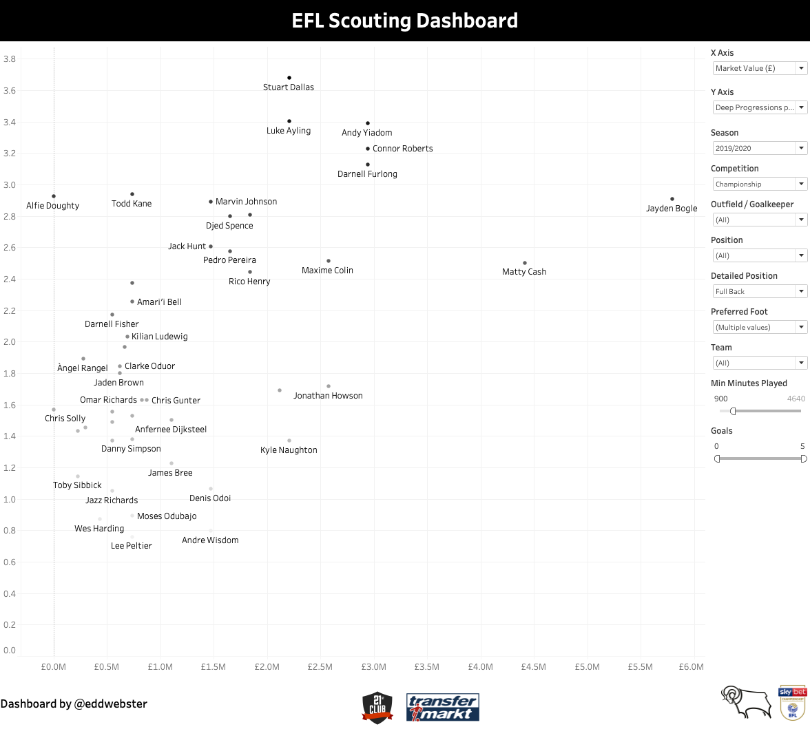
Tool 5: Dynamic Valuation/Value Dashboard
Comparison of real-world performance and estimated market value
Interactive player recruitment dashboard created by fuzzy matching two independent datasets - player performance data from 21st Club and player valuation data from TransferMarkt.
Data can be filtered by:
Season;
Competition;
Estimated Player Value;
Preferred Foot;
Age;
Minutes Played; and
Goals Scored.
The X and Y Axis are dynamic and can be changed to show difference attributes, such as:
Value;
Goals p90 and Assists p90; and
Derived metrics including Deep Progressions p90 ( as shown in this example).
Metrics that could be used to improve the performance of this dashboard with additional data:
‘Potential Impact’ - derived metric based on professional opinion;
Contract expiry information;
International status;
Career league minutes;
Scout reports; and
Current/expected wages.
Player performance data provided by 21st Club and estimated market value data provided by TransferMarkt.

Slide 15
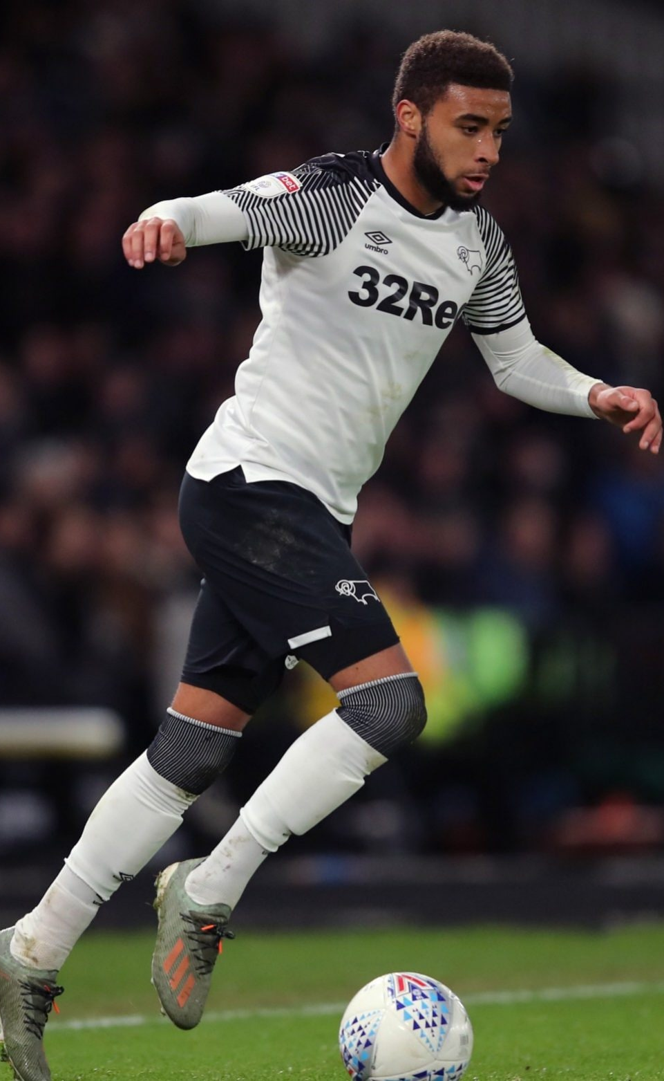
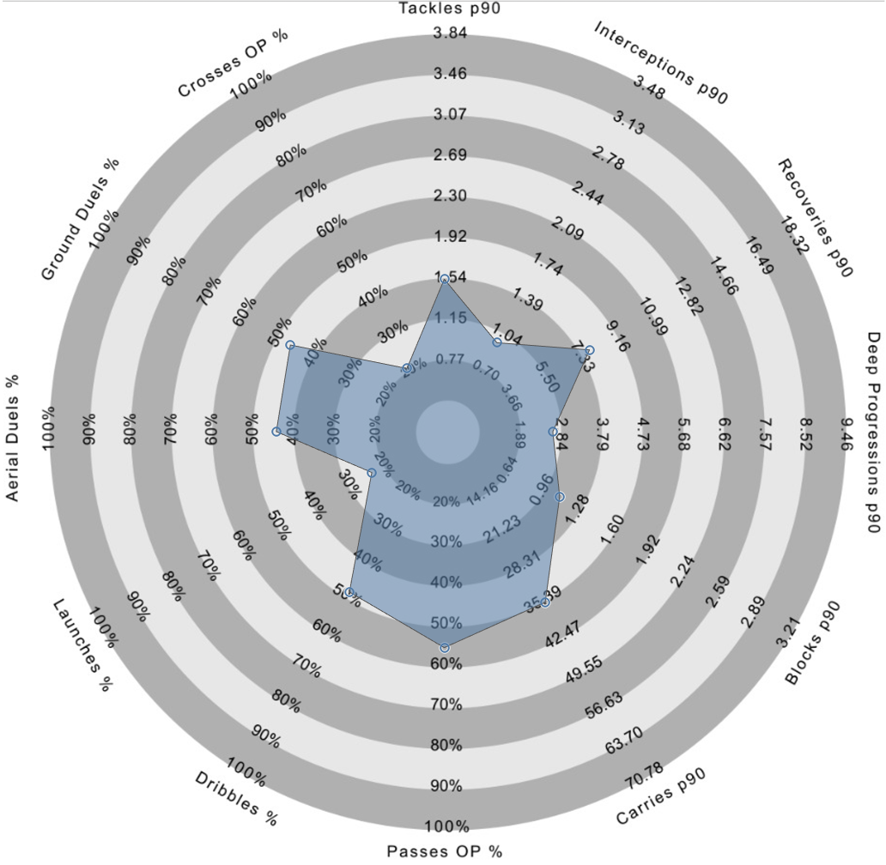
Jayden Bogle
Player profile
DoB: 27/07/2000
Age: 20
Place of birth: Reading
Foot: Right
Height: 1.78m
Nationality: English
Senior International caps (goals): 0 (0)
Main position: Right-Back
Other position(s): Left-Back
Total appearances for Derby County in all competitions: 91
Goals for Derby: 3
Assists for Derby: 17
Estimated market value: £5.67mil
Player performance data provided by 21st Club and estimated market value data provided by TransferMarkt. Correct as of 16th September 2020.

Slide 16
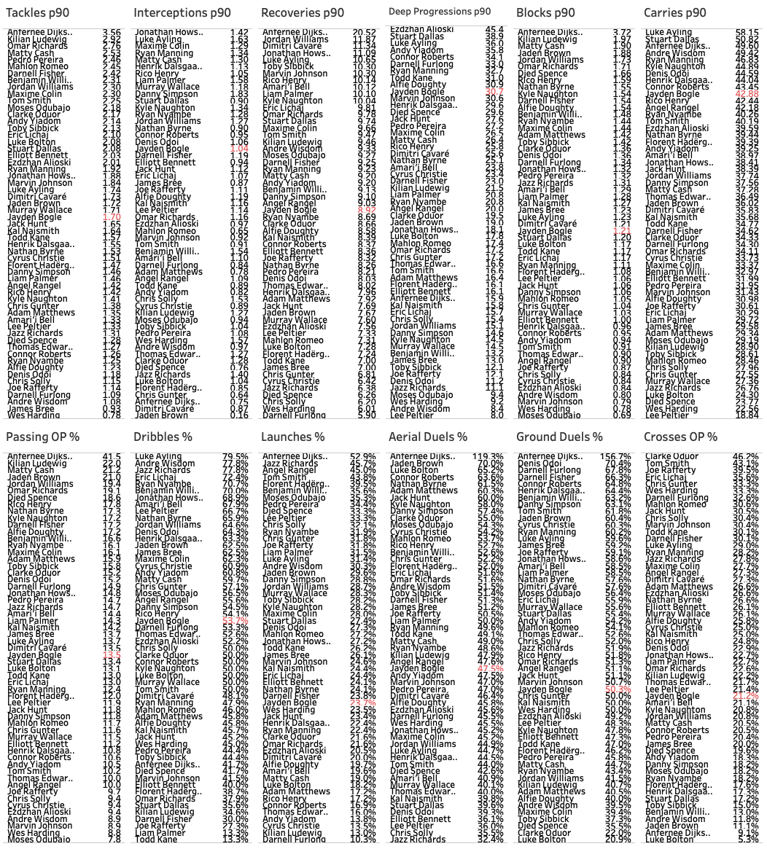
Full-Back Metric Ranking
Comparison of Wingers in the Championship
The Ranking of Players per Metric dashboard for full-backs shows the ranking of the players for the Championship 2019/20 season per twelve selected metrics, deemed to be of most importance. These metrics include: Tackles per 90, Interceptions per 90, Recoveries per 90, Deep Progressions per 90, Blocks per 90, Carries per 90, Passes in Open Play Success %, Dribbles Success %, Launches Success %, Aerial Duels Success %, Ground Duels Success %, Crosses Open Play Success %.
This data has been filtered to show only full-backs, the 2019/20 season, and players that have played at least 10 matches (900 minutes).
Bogle’s (highlighted in red) highest ranked metrics include:
Carries p90 (10th / 42.88),
Deep Progressions p90 (10th / 30.7)
Interceptions (18th / 1.04)
Dribbles Success % (25th / 53.7%)
Recoveries p90 (27th / 8.92)
This data suggests that the strongest aspects of Bogle’s game the attacking-aspect of being a full-back. He contributes significantly to the attack, ranking 10th for Deep Progressions and Carries p90, and ranks less for defensive metrics such as Tackles p90, and Aerial and Ground Duel Success %. These maybe due to Derby’s playing style and actions calibrated per possession may be more appropriate.
As mentioned with the Full-Backs Dashboard, in real world scouting, these metrics would be agreed between the data analysts, the coaches, and the manager, to ensure that players are asses for the right playing style.
Team performance data provided by 21st Club.

Slide 17
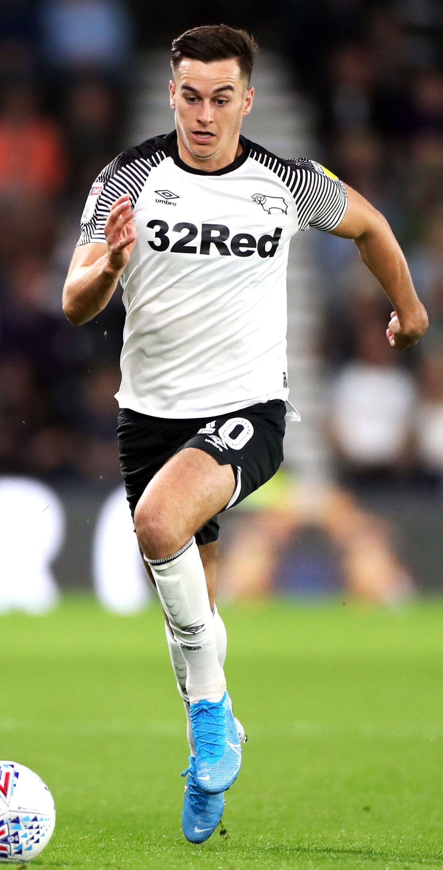
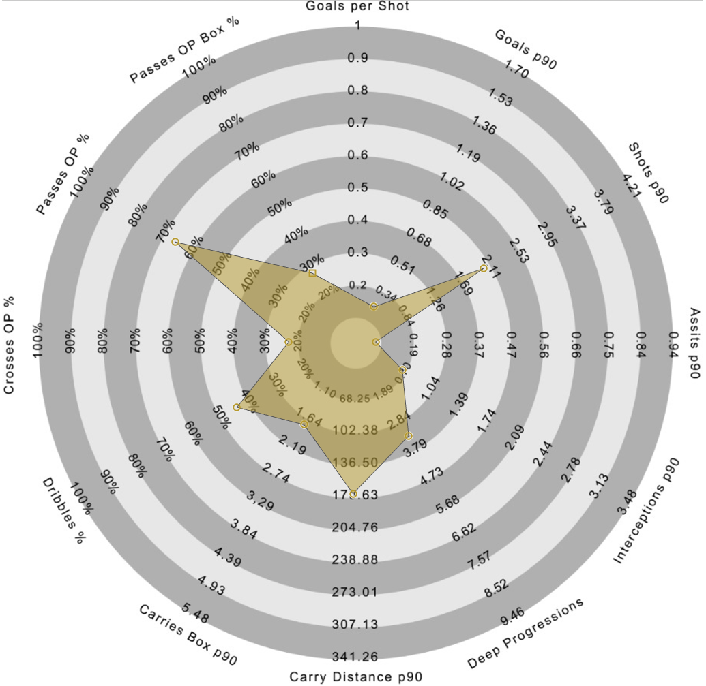
Tom Lawrence
Player profile
DoB: 13/01/1994
Age: 26
Place of birth: Wrexham
Foot: Right
Height: 1.75m
Nationality: Welsh
Senior International caps (goals): 20 (3)
Main position: Left Winger
Other position(s): Second Striker, Right Winger
Total appearances for Derby County in all competitions: 124
Goals for Derby: 23
Assists for Derby: 18
Estimated market value: £4.32mil
Player performance data provided by 21st Club and estimated market value data provided by TransferMarkt. Correct as of 16th September 2020.

Slide 18
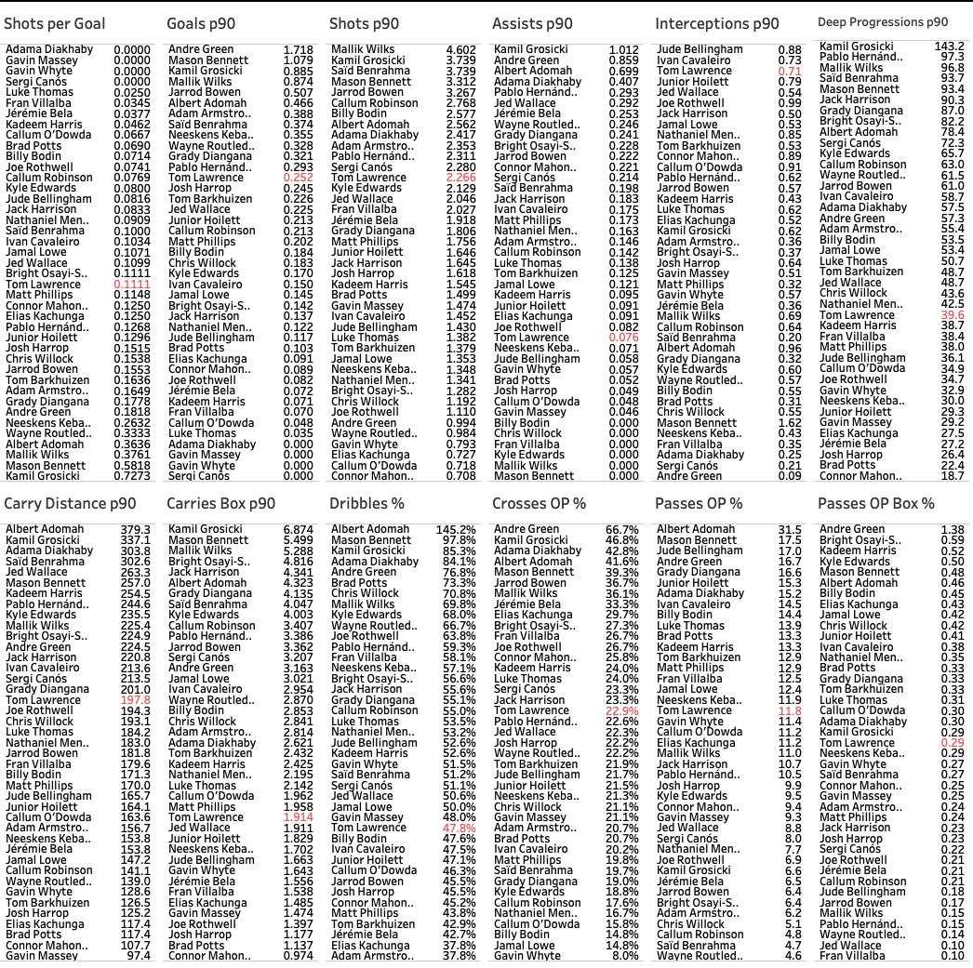
Winger Metric Ranking
Comparison of Wingers in the Championship
The Ranking of Players per Metric dashboard for wingers shows the ranking of the players for the Championship 2019/20 season per the twelve selected metrics, deemed to be of most importance. These metrics include: Shots per Goal, Goals per 90, Shots per 90, Assists per 90, Interceptions per 90, Carry Distance per 90, Carries into the Box per 90, Dribbles Success %, Crosses in Open Play Success %, Passes in Open Play Success % and Passes into the Box in Open Play Success %
This data has been filtered to show only wingers, the most recent 2019/20 season, and players that have played at least 10 matches (900 minutes).
Lawrence’s (highlighted in red) highest ranked metrics include:
Interceptions p90 (3rd / 0.71);
Goals p90 (13th / 0.252);
Shots p90 (13th / 2.226);
Carry Distance p90 (17th / 197.8m);
Crosses OP Success % (18th / 22.9%); and
Passes OP Success % (18th / 11.8%).
This data suggests that Lawrence takes quite a lot of shots but does have quite good output. He also contributes a lot to the team and may likely also be a strong initiator of the press with his rating of 3rd for interceptions. He is also mostprobably Derby’s best outlet when on the attack, carrying the ball and having good passing and crossing accuracy.
As mentioned with the Full-Backs Dashboard, in real world scouting, these metrics would be agreed between the coaches and the manager, and acted upon by the data analysts, not the other way round.
Team performance data provided by 21st Club.

Slide 19
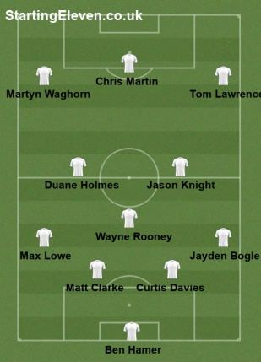
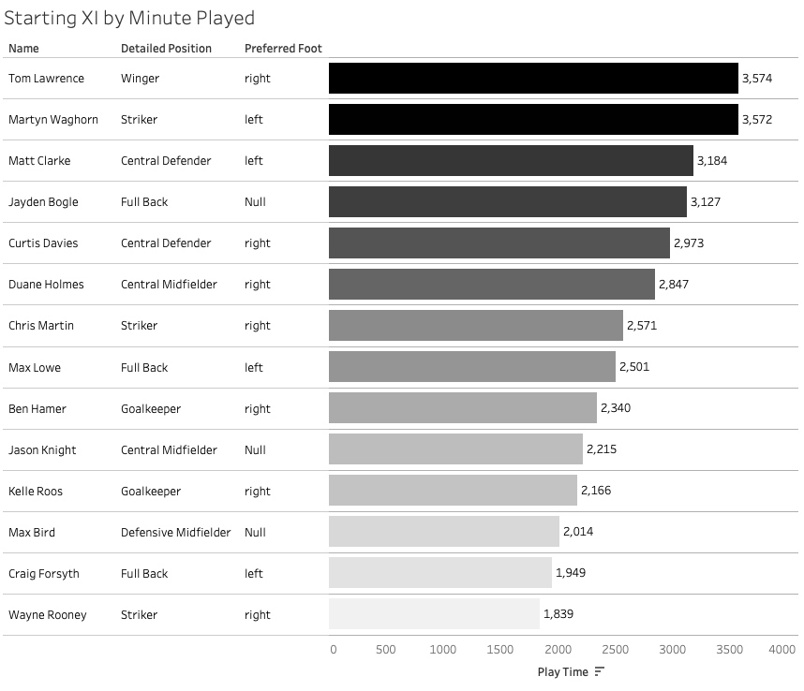
Derby County’s Starting XI
Team Profile - most featured players for the 2019/20 season as per Play Time
Derby’s most common formation was a 4-3-3 with the captain Wayne Rooney playing deep in the midfield.
The players in questions, Tom Lawrence and Jayden Bogle, were both regular starters, featuring 1st (Lawrence) and 4th (Bogle) in terms of minutes during the campaign.
Lawrence was by far Derby’s most used winger, with 3,574 minutes played. The next closest was Florian Jozefzoon with 628 minutes and then Morgan Whittaker with 482 minutes.
Likewise, Bogle was Derby’s most used right-back with 3,127 minutes, ahead of Derby’s alternative right-back Andre Wisdom with 1,583 minutes, who at times played as a centre-back.
Starting XI graphic produced using StartingEleven.co.uk available: https://startingeleven.co.uk/user-formation/325511

Slide 20
Scouting Process
For each player, four potential replacements have been identified. These candidates are categorised as per the following criteria:
Recommendation based on strong performance in the Championship for the 2019/20 season. These players are ‘top-end’ of what can be expected;
Recommendation of an under-23 player for the 2019/20 season, ideally from the Championship;
Recommendation of a player in a division lower than the Championship, ideally League One; and
Recommendation of a strong performing, undervalued player within Derby’s budget, ideally from the Championship.

Slide 21
Player choice 1:
Best performing player in the Championship
for the 2019-2020 season

Slide 22
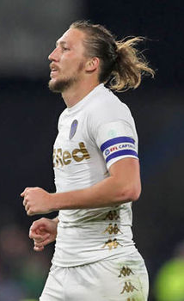
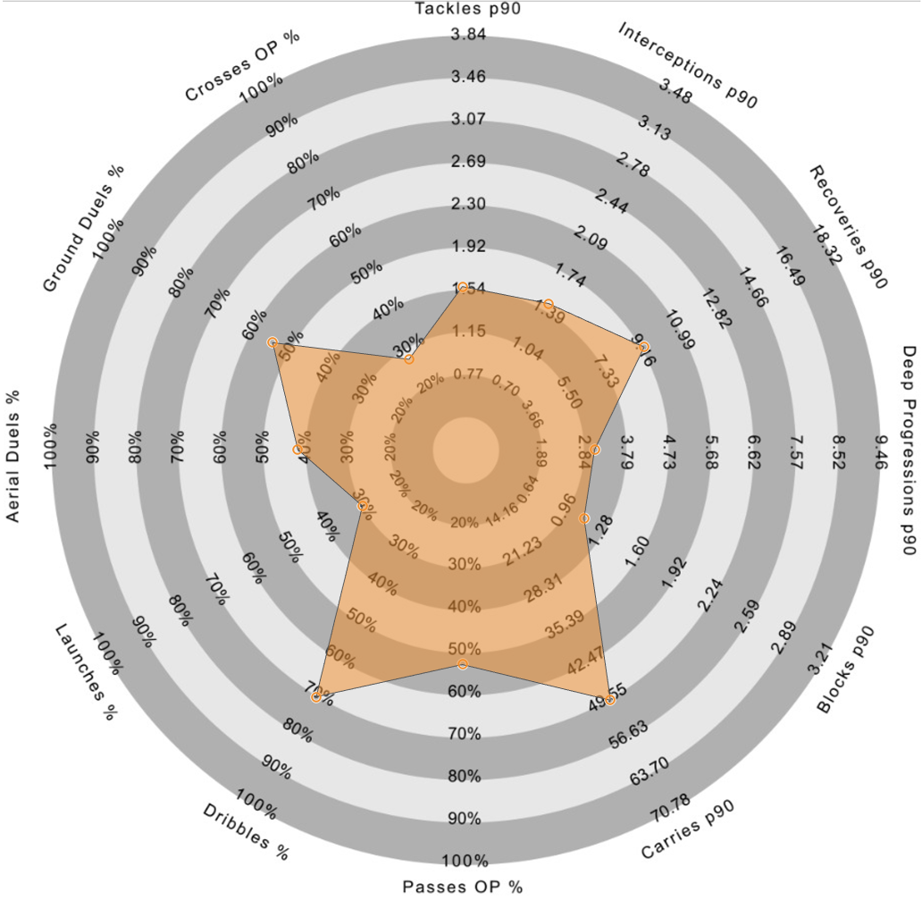
Right-Back Recommendation 1: Luke Ayling
Player profile
DoB: 25/08/1991
Age: 29
Place of birth: London, England
Foot: Right
Height: 1.83m
Nationality: English
Senior International caps (goals): 0 (0)
Main position: Right-Back
Other position(s): Centre-Back
Total appearances for Leeds in all competitions: 156
Goals for Leeds: 6
Assists for Leeds: 16
Estimated market value: £2.16mil
Player performance data provided by 21st Club and estimated market value data provided by TransferMarkt. Correct as of 16th September 2020.

Slide 23
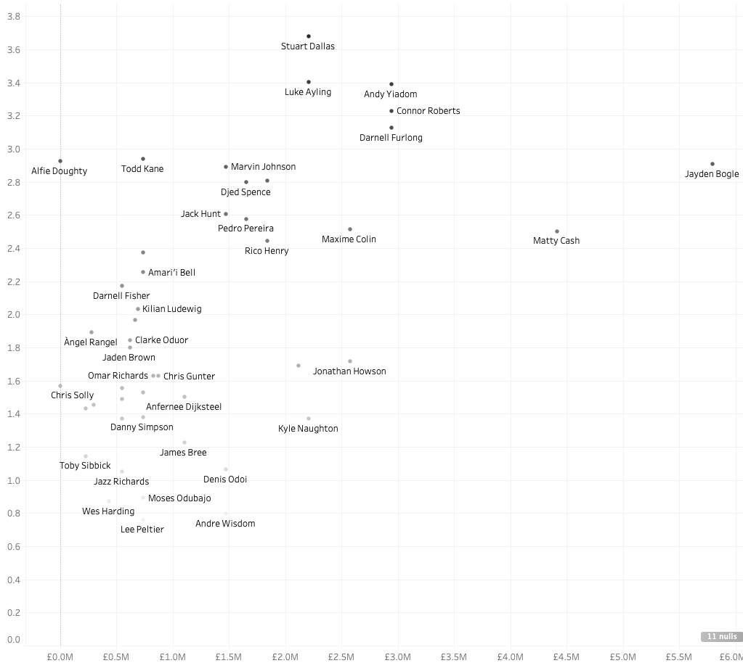
Right-Back Recommendation 1: Luke Ayling
Deep Progressions per 90 Player against Estimated Market Value
A strong aspect of Bogle’s game is his contribution of Deep Progressions p90, where he finished the 2019/20 season 10th (30.7), a metric in which Ayling of Leeds United finished 1st (36.0), which would suggest he would suit Derby’s playing style.
Ayling also finished 1st for Interceptions p90 (1.63), Carries p90 (58.15), Dribbles % (79.5%). He finished 2nd for Recoveries p90 (10.65) and in the top 10 for other full-back metrics including Tackles p90, Ground Duels %, and Crosses OP%.
Ayling’s performance have been recognised outside of the stats. For the 2019/20 season, Ayling was promoted to the Premier League with Leeds United, was named in Professional Footballers' Association's 2019–20 EFL Championship Team of the Season and also won the EFL Championship PFA Player of the Year for 2019/20 award after beating off competition from nominees including Ollie Watkins and Aleksandar Mitrovic.
Since Leeds have since been promoted to the Premier League, Ayling is most likely out of price range of most Championship teams, including Derby, and he is unlikely to want to leave the club during a Premier League campaign.
Region of highly performing full-backs regarding Deep Progressions p90 contributions
Player performance data provided by 21st Club and estimated market value data provided by TransferMarkt.
All players have been filtered for Full-Back; Right, Both, or Null foot; and have played at least 10 matches (900 minutes)

Slide 24
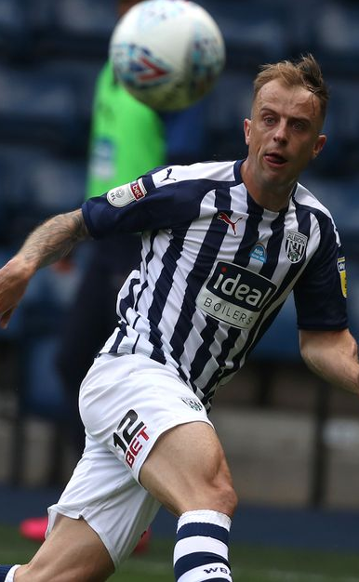
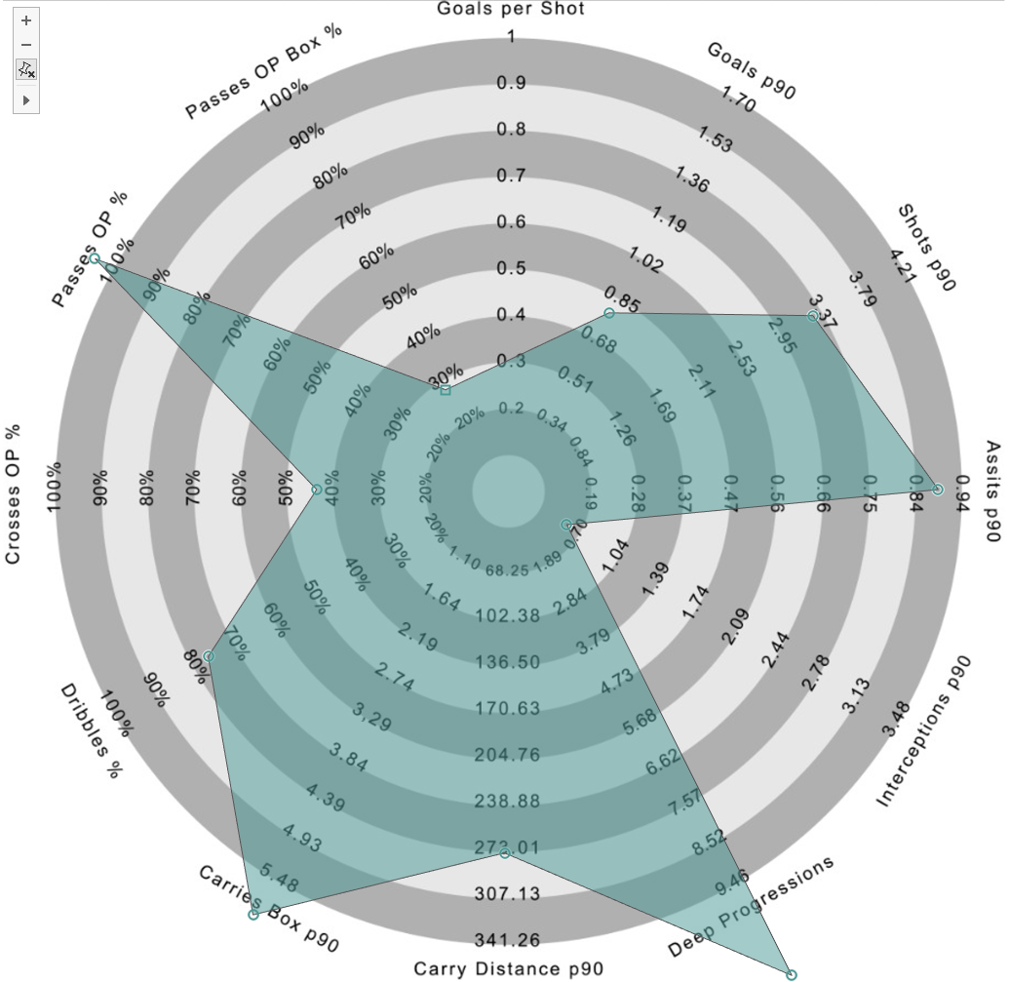
Right-Winger Recommendation 1: Kamil Grosicki
Player profile
DoB: 08/06/1988
Age: 32
Place of birth: Szczecin, Poland
Foot: Right
Height: 1.80m
Nationality: Polish
Senior International caps (goals): 75 (14)
Main position: Left Winger
Other position(s): Right Winger
Total appearances for West Brom in all competitions: 15
Goals for West Brom: 1
Assists for West Brom: 3
Estimated market value: £2.16mil
Player performance data provided by 21st Club and estimated market value data provided by TransferMarkt. Correct as of 16th September 2020.

Slide 25
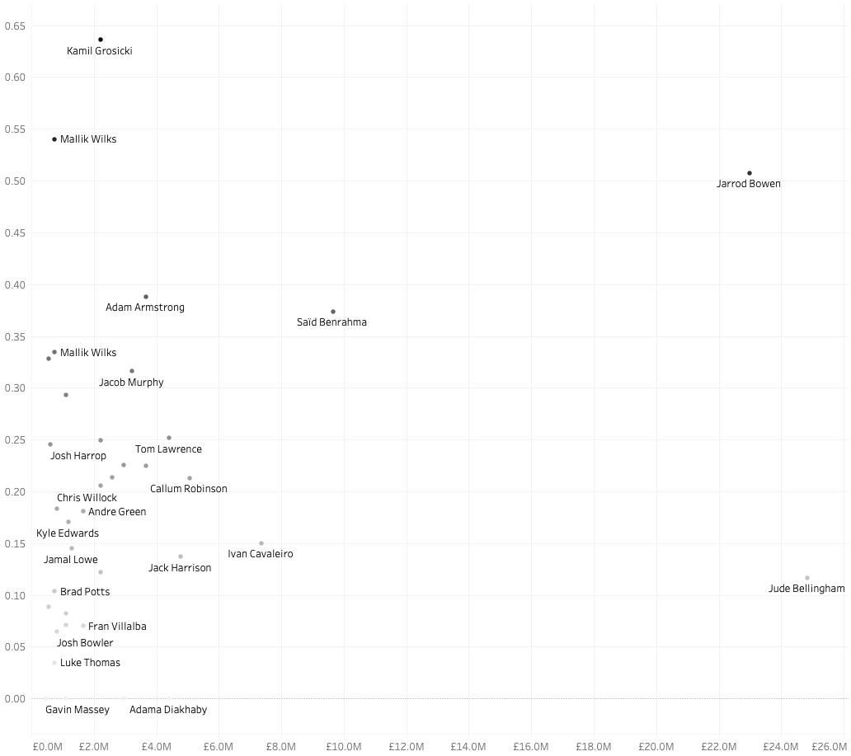
Winger Recommendation 1: Kamil Grosicki
Goals per 90 Player against Estimated Market Value
A strong aspect of Lawrence’s game is his goal contribution to the team with 0.252 Goals per 90 minutes (13th in the Championship for 2019/20), a metric in which Grosicki of West Brom finishes 3rd (0.885).
Grosicki also finished 2nd for Shots p90 (3.739), 1st for Assists p90 (1.012), 1st for Deep progressions p90 (143.2), 2nd for Carry Distance p90 (337.1), 1st for Carries into the Box p90 (6.874), 3rd for Dribbles % Success (85.3%), and 2nd for Cross in Open Play Success % (46.8%).
Grosicki statistics and data should be checked as the radar produces is over 100% in places.
Since West Brom have since been promoted to the Premier League and Grosicki has only joined the club in January 2020, he is most likely out of price range of most Championship teams, including Derby, and he is unlikely to want to leave the club during a Premier League campaign.
Looking outside of the data, despite being right-footed, Grosicki plays as an inverted left-winger, another position Derby have a lack of depth, but he would not be a direct replace for Lawrence on the right-wing
Grosicki is a highly experience player at 32 years of age and over 70 caps for his country. He would potentially have a lower transfer fee (estimated £2.16mil as per TransferMarkt), however, he may have higher wage demands and Derby might be better replacing Lawrence with a younger, up-and-coming player.
Region of highly performing wingers regarding Goals p90
Player performance data provided by 21st Club and estimated market value data provided by TransferMarkt.
All players have been filtered for Winger; Right, Both, or Null foot; and have played at least 10 matches (900 minutes)

Slide 26
Player choice 2:
Best U-23 player in the Championship
for the 2019-2020 season

Slide 27
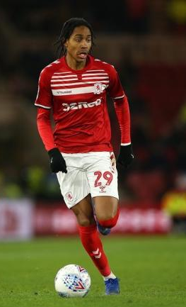
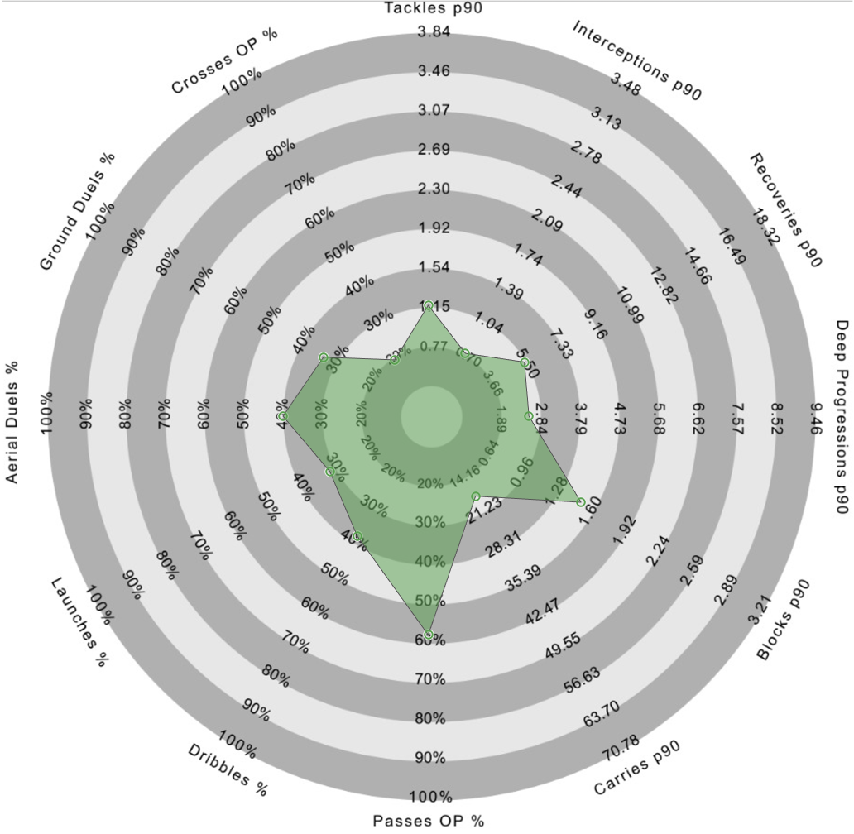
Right-Back Recommendation 2: Djed Spence
Player profile
DoB: 09/08/2000
Age: 20
Place of birth: London, England
Foot: Right
Height: 1.84m
Nationality: English
Senior International caps (goals): 0 (0)
Main position: Right-Back
Other position(s): n/a
Total appearances for Middlesbrough in all competitions: 29
Goals for Middlesbrough: 1
Assists for Middlesbrough: 0
Estimated market value: £1.62mil
Player performance data provided by 21st Club and estimated market value data provided by TransferMarkt. Correct as of 16th September 2020.

Slide 28
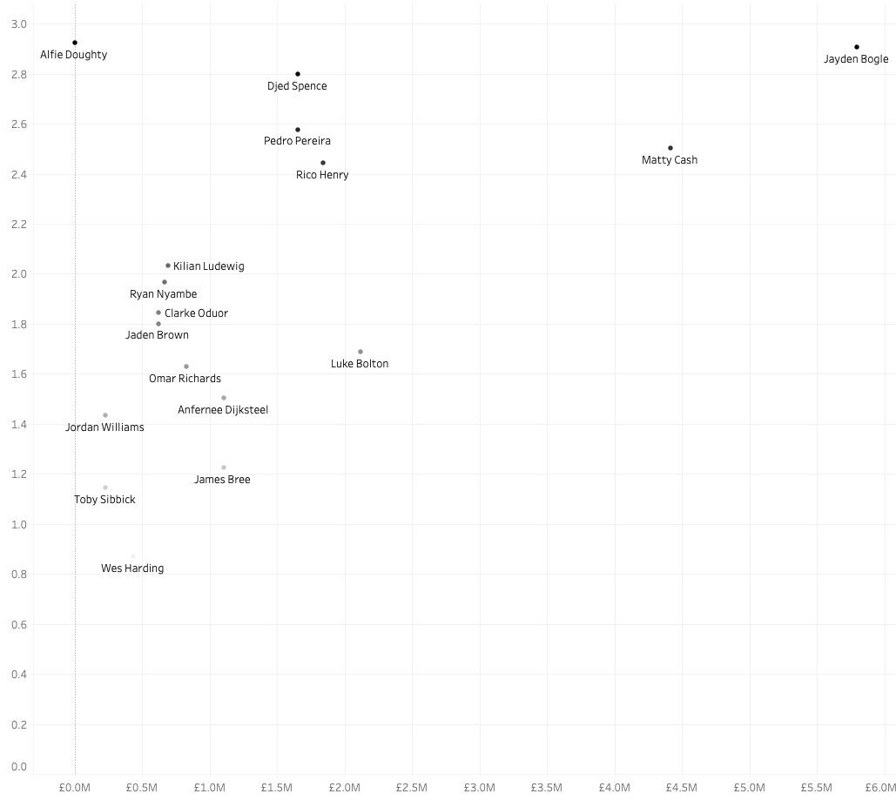
Right-Back Recommendation 2: Djed Spence
Deep Progressions per 90 Player against Estimated Market Value
A strong aspect of Bogle’s game is his contribution of Deep Progressions p90, where he finished the 2019/20 season 2nd (30.7) for U-23 players, a metric in which Spence of Middlesbrough finished 3rd (29.6), which would suggest he would suit Derby’s playing style.
Alfie Doughty finishes 1st for all U-23 players for Deep Progressions per 90 minutes with 30.9, just ahead of Bogle. However, despite being both left and right-footed in the 21st Club dataset, as per TransferMarkt he is a left-back/left-midfielder and for this reason he has been discounted as a possible candidate.
Spence also finished 6th for Blocks p90 (1.66) and 6th for Passing Open Play Success % (18.6) for U-23 players in the Championship.
According to TransferMarkt, Spence’s current value is £1.7M compared with Bogles of £5.8M, £3.9M. Spence may well be within Derby’s price range
Region of highly performing full-backs regarding Deep Progressions p90 contributions
Player performance data provided by 21st Club and estimated market value data provided by TransferMarkt.
All players have been filtered for Full-Back; Right, Both, or Null foot; and have played at least 10 matches (900 minutes)

Slide 29
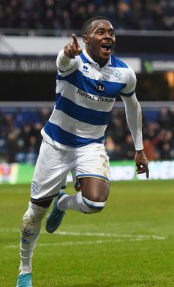
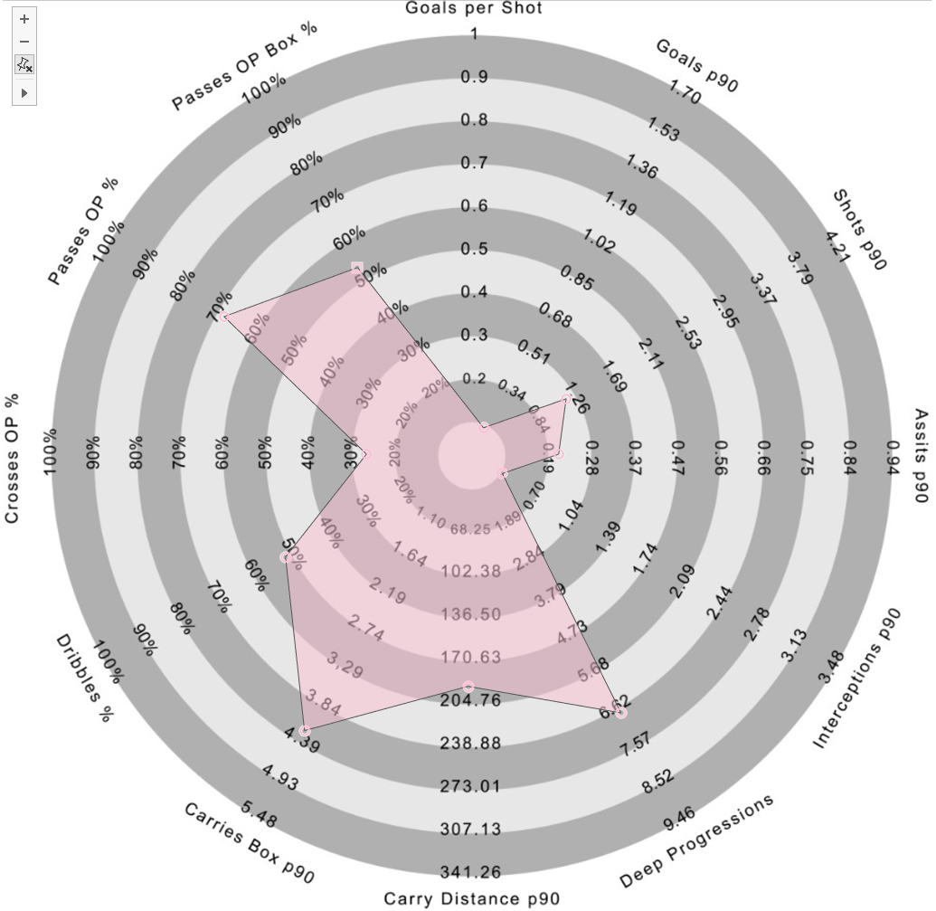
Right-Winger Recommendation 2: Bright Osayi-Samuel
Player profile
DoB: 31/12/1997
Foot: Right
Place of birth: Okija, Nigeria
Age: 22
Height: 1.75m
Nationality: Nigerian/English
Senior International caps (goals): 0 (0)
Main position: Right-Winger
Other position(s): Left-Winger
Total appearances for QPR in all competitions: 95
Goals for QPR: 10
Assists for QPR: 10
Estimated market value: £1.53mil
Player performance data provided by 21st Club and estimated market value data provided by TransferMarkt. Correct as of 16th September 2020.

Slide 30
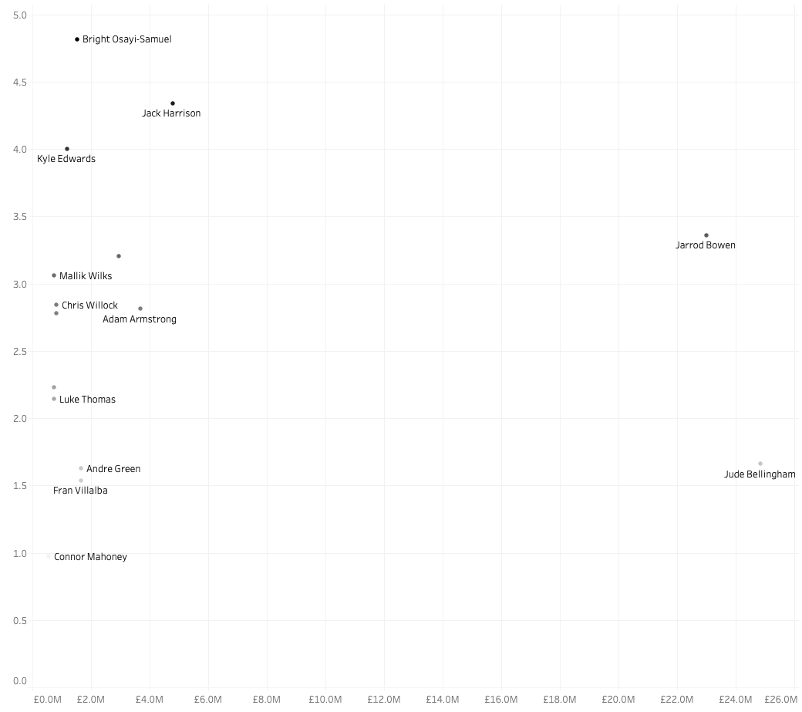
Winger Recommendation 2: Oyasi-Samuel
Goals per 90 Player against estimated market value
A strong aspect of Lawrence’s game is his goal contribution to the team with 0.252 Goals per 90 minutes (13th in the Championship for 2019/20), a metric in which Oyasi-Samuel of QPR finishes 3rd for U-23 players with 0.1425 goals.
Other U-23 players such as Jarrod Bowen (West Ham), Kyle Edwards (West Brom), and Grady Diangana (West Brom), who have a higher Goals per 90 minutes, all now play in the Premier League. Chris Willock who was on Loan at Arsenal is now currently with Benefica B in Portugal. For this reason, these players have been discounted as potential candidates.
Oyasi-Samuel is a consistently good performer in the Championship, with many other strong aspects to his game when compared with other U-23s, finishing 1st for Carries in the Box p90 (4.816), 1st for Passes Open Play into the Box Success % (59%), 2nd for Carry Distance p90 (224.9m), 2nd for Assists p90 (0.2280), 2nd for Crosses Open Play Success % (27.3%), 3rd for Deep Progressions (82.2), 4th for Dribbles Success % (56.6%), and 7th for Interceptions p90 (0.37).
Another potential player of interest regarding high Goals p90 output is Adam Armstrong of Blackburn Rovers. Armstrong however has a higher market value of £3.6M according to TransferMarkt.
Region of highly performing wingers regarding Carries into the Box p90
Player performance data provided by 21st Club and estimated market value data provided by TransferMarkt.
All players have been filtered for Winger; Right, Both, or Null foot; and have played at least 10 matches (900 minutes)

Slide 31
Player choice 3:
Best performing player outside the Championship
for the 2019-2020 season

Slide 32
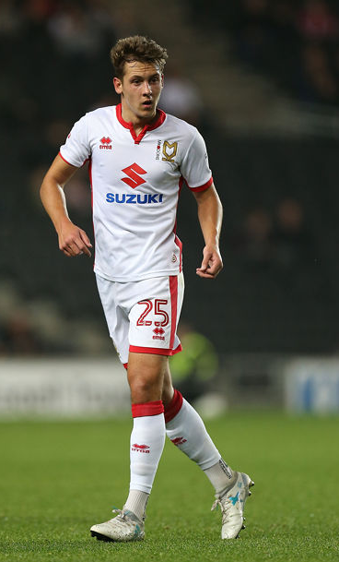
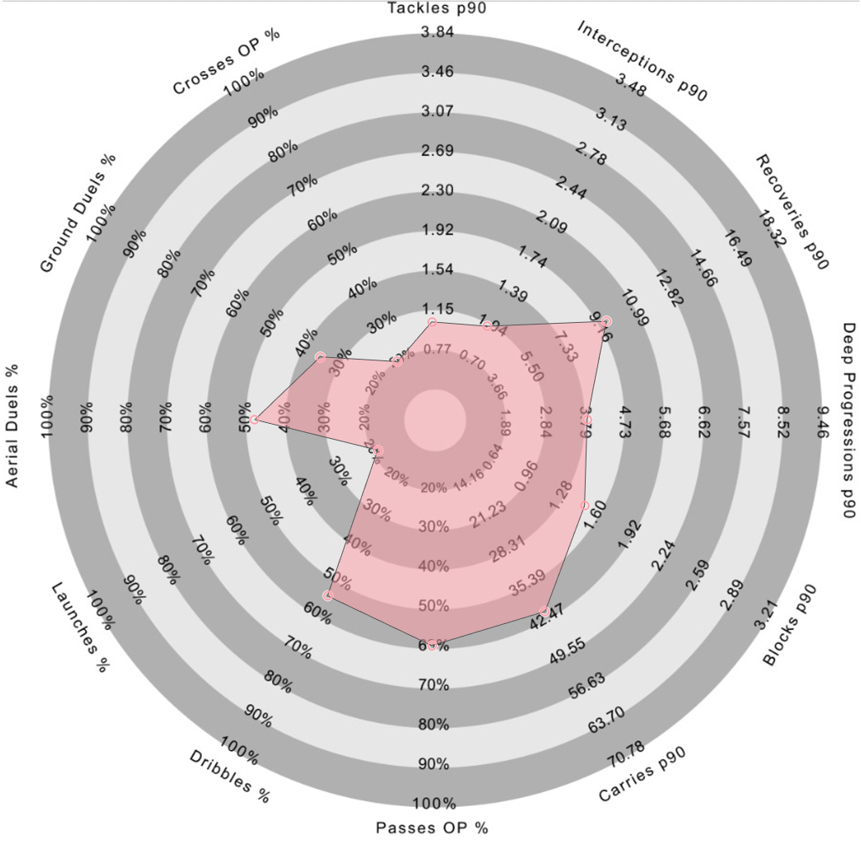
Right-Back Recommendation 3: Callum Brittain
Player profile
DoB: 12/03/1998
Age: 22
Place of birth: Bedford, England
Foot: Right
Height: 1.79m
Nationality: English
Senior International caps (goals): 0 (0)
Main position: Right-Back
Other position(s): n/a
Total appearances for MK Dons in all competitions: 118
Goals for MK Dons: 5
Assists for MK Dons: 4
Estimated market value: £225k
Player performance data provided by 21st Club and estimated market value data provided by TransferMarkt. Correct as of 16th September 2020.

Slide 33
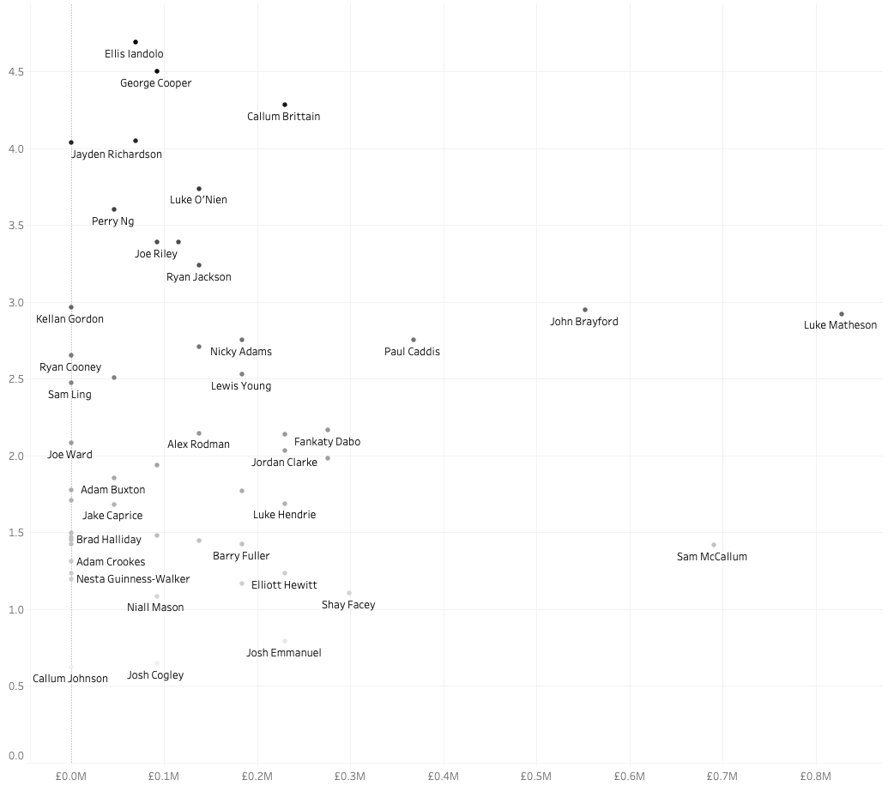
Right-Back Recommendation 3: Callum Brittain
Deep Progressions per 90 Player against estimated market value
A strong aspect of Bogle’s game is his contribution of Deep Progressions p90, where he finished 4th in the Championship for the 2019/20 season (30.7), a metric in which Callum Brittain finished 1st for League One (45.2), which would suggest he would suit Derby’s playing style.
Brittain also finished League One 2nd for Carries p90 (49.68), 8th for Recoveries p90, 9th for Dribbles Success % (60.7%), 11th for Passing Open Play Success % (18.4%), and 11th for Blocks p90 (1.65).
Brittain is also 22 years of age and would qualify as an U-23 selection instead of Djed Spence. He has played over 100 games for MK Dons at just 22 years of age, which suggests that despite his young age, he has already had a lot of first team experience and would have the potential to make the jump up to league one.
With an estimated value of £225k as per TransferMarkt, compared with Djed Spence valued at £1.62mil, Brittain may potentially be a under-valued player that would have the potential to improve as a player.
In 118 games, Brittain has 5 goals and 4 assists. This may be due to MK Dons style of play, but Bogle with 17 assists with a similar number of games (91) has a greater output and Brittain would maybe need to improve his on his contribution to goals. Of course, assists don’t always tell the full story, and Brittain’s contribution may show up better for other metrics such as Expected Threat (xT).
Region of highly performing full-backs regarding Deep Progressions p90 contributions
Player performance data provided by 21st Club and estimated market value data provided by TransferMarkt.
All players have been filtered for Full-Back; Right, Both, or Null foot; and have played at least 10 matches (900 minutes)

Slide 34
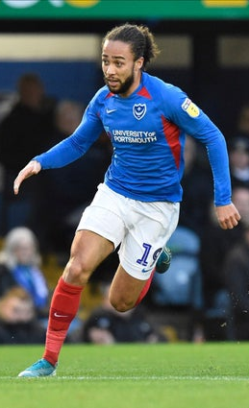
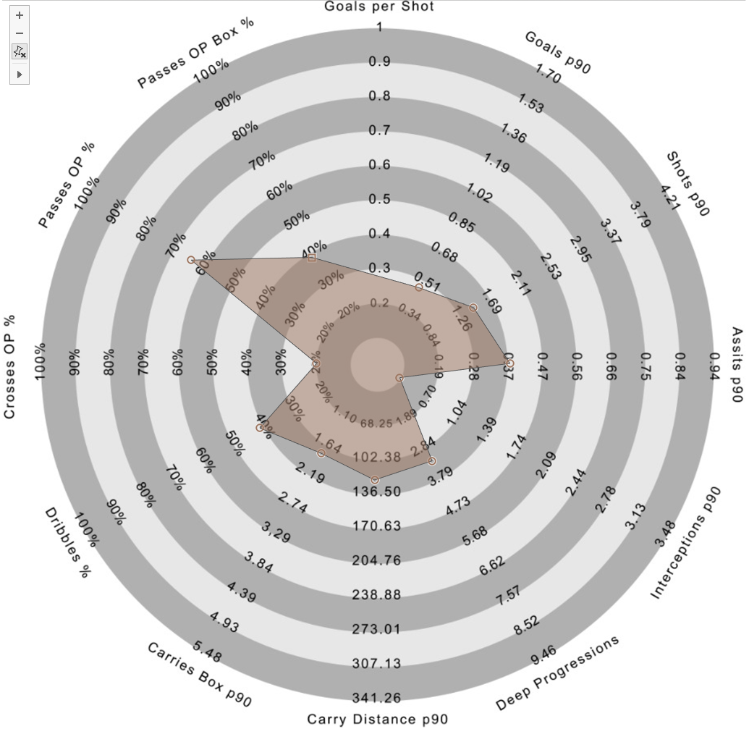
Right-Winger Recommendation 3: Marcus Harness
Player profile
DoB: 24/02/1996
Age: 24
Place of birth: Coventry, England
Foot: Right
Height: 1.82m
Nationality: English
Senior International caps (goals): 0 (0)
Main position: Right-Winger
Other position(s): Left-Winger, Attacking Midfield
Total appearances for Portsmouth in all competitions: 41
Goals for Portsmouth: 12
Assists for Portsmouth: 6
Estimated market value: £900k
Player performance data provided by 21st Club and estimated market value data provided by TransferMarkt. Correct as of 16th September 2020.

Slide 35
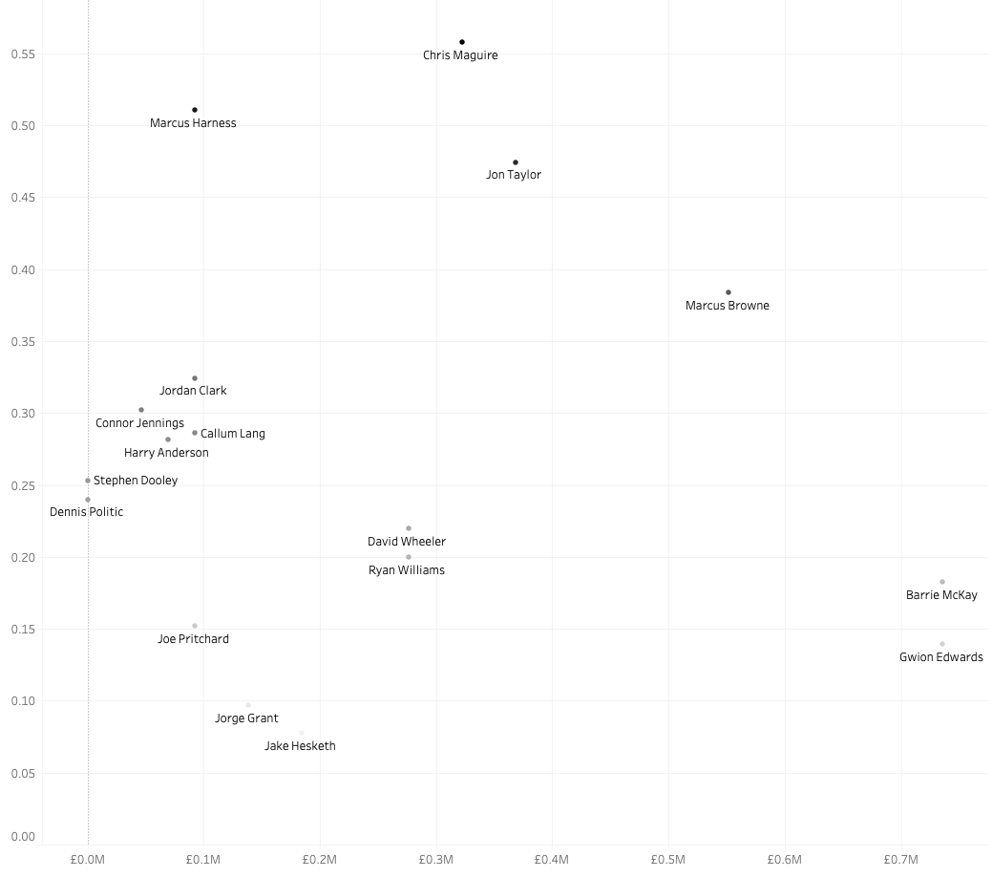
Winger Recommendation 3: Marcus Harness
Goals per 90 Player against estimated market value
A strong aspect of Lawrence’s game is his goal contribution to the team with 0.252 Goals per 90 minutes (13th,in the Championship for 2019/20, a metric in which Marcus Harness of Portsmouth in League One finishes 5th (0.51).
Harness also finished 2nd for Assists p90 (0.43), 6th for Passes Open Play into the Box Success % (42%), 12th for Carries into the Box per 90 (1.96).
At 24 years old, Harness does not fit within the U-23 category, but he is still a young-player that shows good end-product statistic in terms of goals and assists per 90 mins.
Harness has an estimated market value of £90k, a player that would be within Derby’s budget.
Other considered players included Sunderland’s Chris Maguire and Rotherham’s Kieran Sadlier. Despite the data showing he plays with both feet, Sadlier from additional research is a left-winger and was discount. Maguire was also discount as at 31 years old, he may have less opportunity to continue to grow to be Championship level.
Other potential players include Lynden Gooch of Sunderland who at 24, may also be a good potential target with 0.55 Goals per 90 mins. He performs less well with assists (0.055 per 90 mins), for this reason, Harness was selected.
Region of highly performing wingers regarding Goals p90
Player performance data provided by 21st Club and estimated market value data provided by TransferMarkt.
All players have been filtered for Winger; Right, Both, or Null foot; and have played at least 10 matches (900 minutes)

Slide 36
Player choice 4:
Strong Performing Championship players within Budget
for the 2019-2020 season

Slide 37
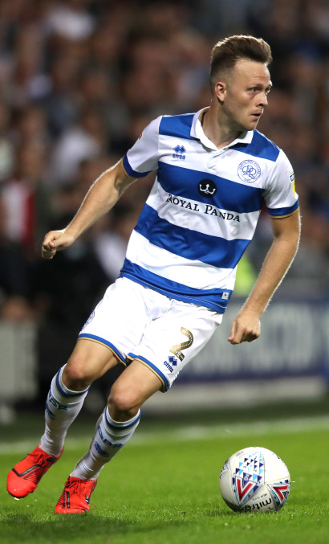
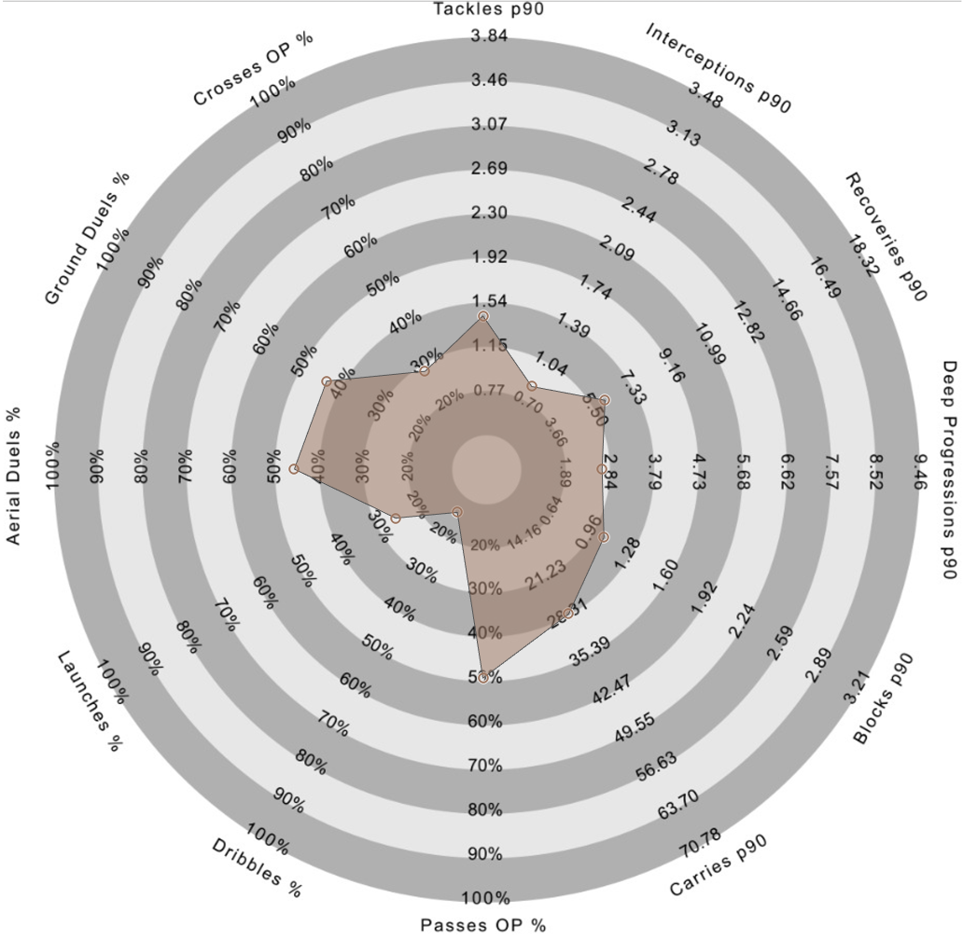
Right-Back Recommendation 4: Todd Kane
Player profile
DoB: 17/09/1993
Age: 27
Place of birth: Huntingdon, England
Foot: Right
Height: 1.80m
Nationality: English
Senior International caps (goals): 0 (0)
Main position: Right-Back
Other position(s): n/a
Total appearances for QPR in all competitions: 36
Goals for QPR: 1
Assists for QPR: 2
Estimated market value: £720k
Player performance data provided by 21st Club and estimated market value data provided by TransferMarkt. Correct as of 16th September 2020.

Slide 38
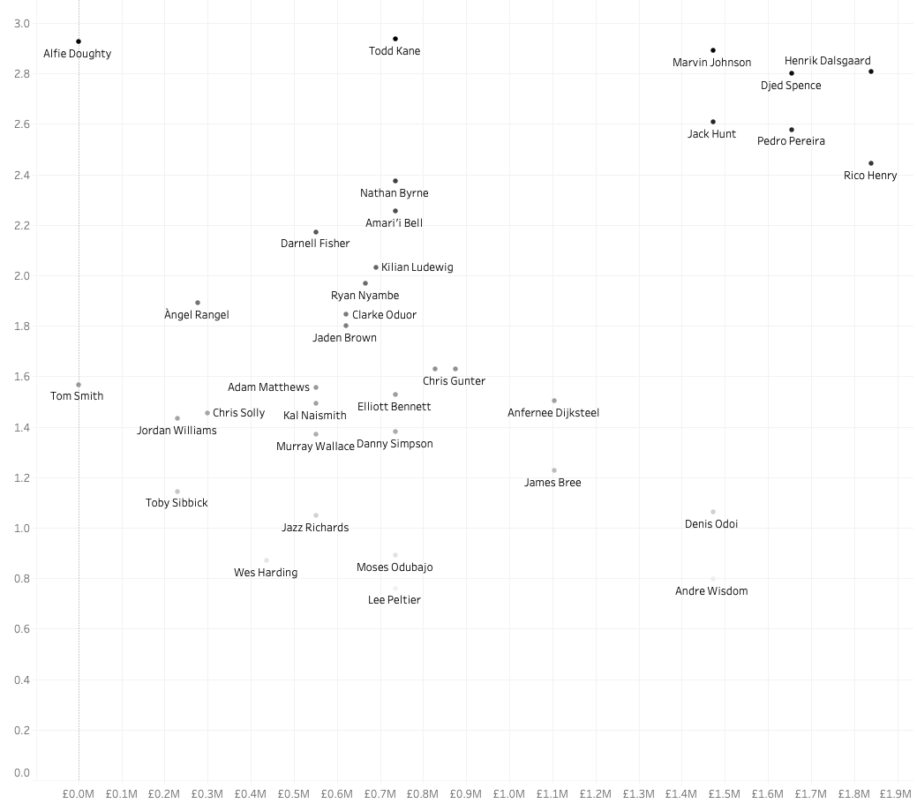
Right-Back Recommendation 4: Todd Kane
Deep Progressions per 90 Player against estimated market value
A strong aspect of Bogle’s game is his contribution of Deep Progressions p90, where he finished the 2019/20 season 4th (30.7), a metric in which Kane finishes slightly ahead with 31.0.
For this analysis, the players were filtered for values of £2M or under according to TransferMarkt to try and find players within Derby’s budget.
Kane is 27 years of age and value at £720k according to TransferMarkt. He is potentially an under-valued right-back.
Region of highly performing full-backs regarding Deep Progressions p90 contributions
Player performance data provided by 21st Club and estimated market value data provided by TransferMarkt.
All players have been filtered for Full-Back; Right, Both, or Null foot; and have played at least 10 matches (900 minutes)

Slide 39
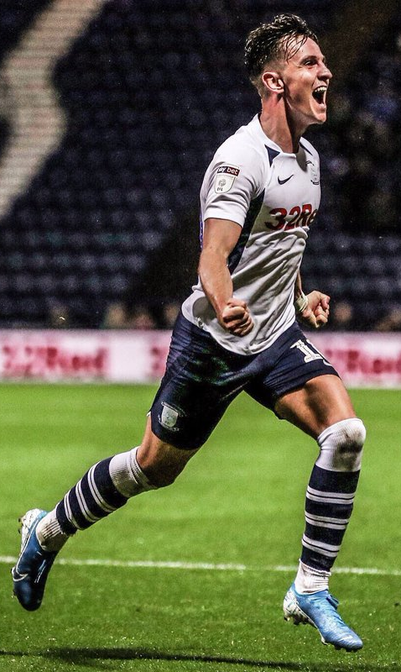
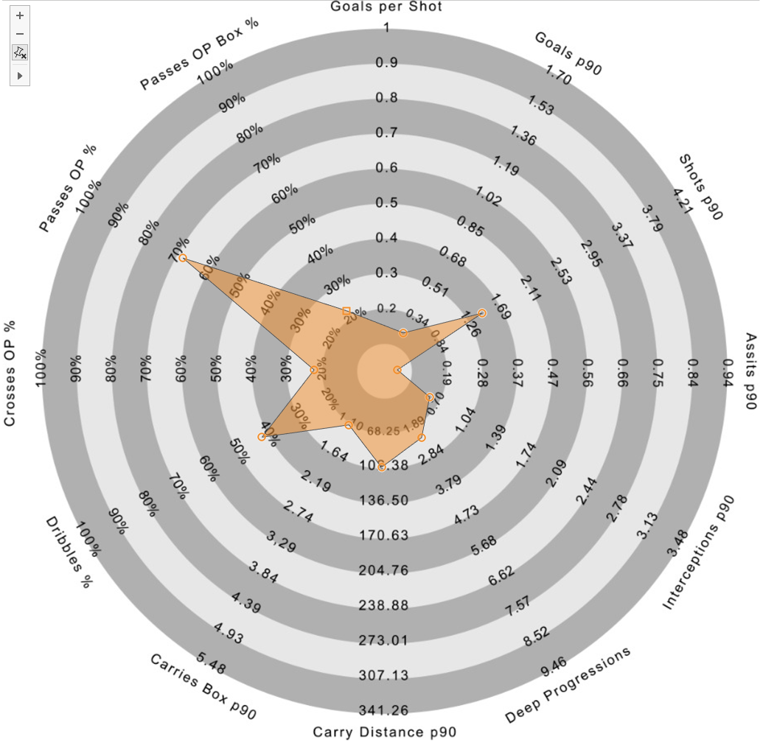
Right-Winger Recommendation 4: Josh Harrop
Player profile
DoB: 15/12/1995
Age: 24
Place of birth: Stockport
Foot: Right
Height: 1.75m
Nationality: English
Senior International caps (goals): 0 (0)
Main position: Right-Winger
Other position(s): Attacking-Midfield
Total appearances for Preston in all competitions: 88
Goals for X: 13
Assists for X: 5
Estimated market value: £585k
Player performance data provided by 21st Club and estimated market value data provided by TransferMarkt. Correct as of 16th September 2020.

Slide 40
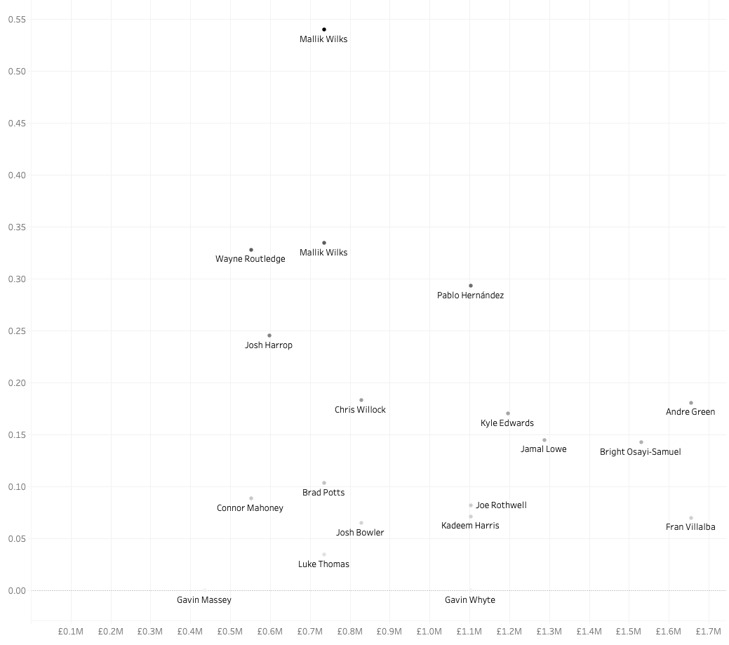
Winger Recommendation 4: Josh Harrop
Goals per 90 Player against estimated market value
A strong aspect of Lawrence’s game is his goal contribution to the team with 0.252 Goals per 90 minutes (13th in the Championship for 2019/20), a metric in which Harrop finishes slightly behind with 0.245 Goals per 90 minutes.
For this analysis, the players were filtered for values of £2M or under according to TransferMarkt to try and find players within Derby’s budget.
Harrop is 24 years of age, much younger than other stronger performers for Goals per 90 minutes that are also under £2M such as Pablo Hernandez (35) of recently promoted Leeds United and Wayne Routledge (35) of Swansea City.
Mallik Wilks of Hull City was also considered due to his strong statistics for Goals p90 (0.874) and Deep Progressions (96.8). However, he is considered a Left-Winger according to TransferMarkt and was therefore discounted in this analysis to find a direct replacement for Lawrence on the right-wing. He could however prove a good signing on the left-wing, a position in which Derby are also light, or be converted to a right-winger. Wilks is valued at £720k according to TransferMarkt.
Region of highly performing wingers regarding Goals p90
Player performance data provided by 21st Club and estimated market value data provided by TransferMarkt.
All players have been filtered for Winger; Right, Both, or Null foot; and have played at least 10 matches (900 minutes)

Slide 41
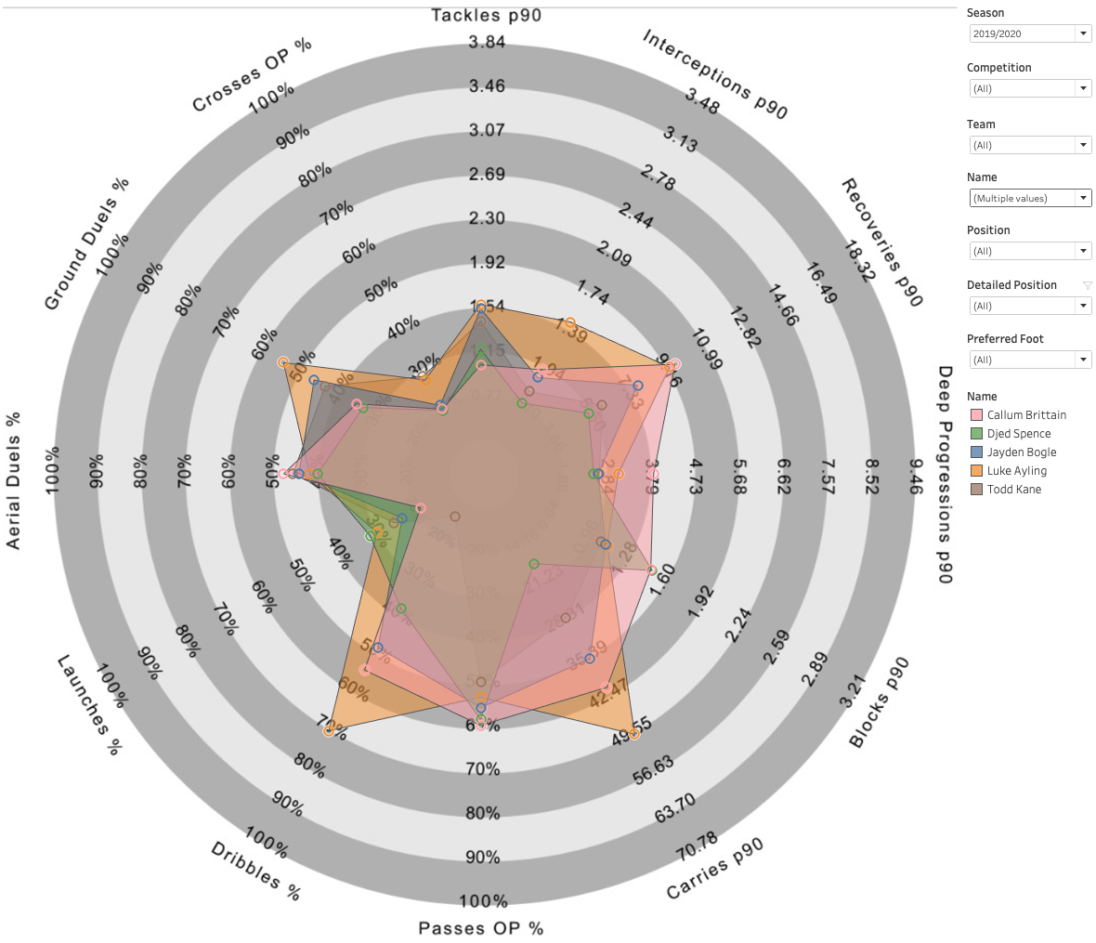
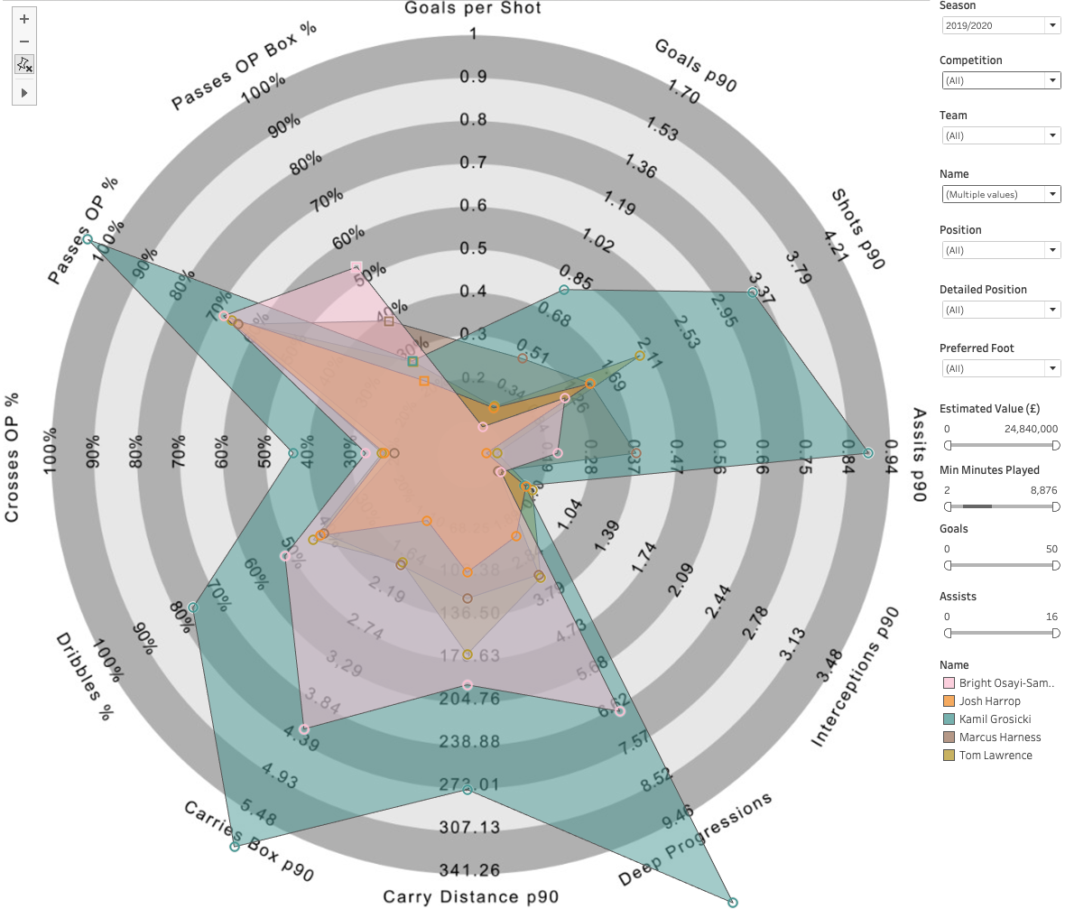
Conclusion
Examples of analysis I plan/wish to conduct with more time and/or data
Scouted players per position are:
Right-Back
Luke Ayling (Leeds)
Djed Spence (Middlesbrough)
Callum Brittain (MK Dons)
Todd Kane (QPR)
Right-Wing
Kamil Grosicki (West Bromwich Albion)
Bright Osayi-Samuel (QPR)
Marcus Harness (Portsmouth)
Josh Harrop (Preston)
Right-Backs:
Right-Wingers:

Slide 42
Next Steps…
Examples of analysis I plan/wish to conduct with more time and/or data
Formation analysis – further analyse player that fit into certain playing styles e.g. three-at-the-back formations, 4-3-3, strikers that play in a two, etc. This data has been provided but was not analysed within the timeframe.
Principle Component Analysis (PCA) of players similarity. Potentially try and find the metrics most associated to players with a higher TransferMarkt value. This would require most likely require significant volumes of Event data.
Further improvement of the Knutson radars [link] of player metrics. Certain metrics could be standardised better with more time. Improved metrics could be included, such as: Expected Goals (xG), Expected Assists (xA), xGBuildup, and Expected Threat (xT) metrics and subsequent derived metrics such a Pressures. The radars would all benefit from possession adjustment of certain metrics.

Slide 43
Appendix

Slide 44
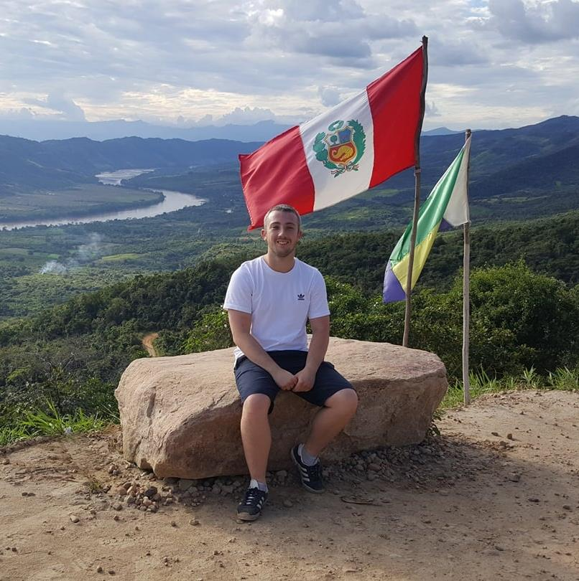
For More Information
If you would like to find out more…
Tableau Public profile: public.tableau.com/profile/edd.webster. See the dashboard titled 'Edd Webster Plymouth Argyle Data Analysis’ for the dashboards featured in this deck.
GitHub:
General: github.com/eddwebster
Football analytics specifically, including all notebooks to scrape, wrangle and engineer the data used in this notebook: github.com/eddwebster/derby_county_data_task
Website: eddwebster.com
LinkedIn: linkedin.com/in/eddwebster
Twitter: @eddwebster
Email: edd.j.webster@gmail.com

Slide 45
References
Player profile Information:
Jayden Bogle:
Tom Lawrence: https://www.transfermarkt.co.uk/tom-lawrence/profil/spieler/229970
Luke Ayling: https://www.transfermarkt.co.uk/luke-ayling/profil/spieler/67420
Kamil Grosicki: https://www.transfermarkt.co.uk/kamil-grosicki/profil/spieler/37920
Djed Spence: https://www.transfermarkt.co.uk/djed-spence/profil/spieler/483348
Bright Osayi-Samuel: https://www.transfermarkt.co.uk/bright-osayi-samuel/profil/spieler/358948
Callum Brittain: https://www.transfermarkt.co.uk/callum-brittain/profil/spieler/416368
Marcus Harness: https://www.transfermarkt.co.uk/marcus-harness/profil/spieler/288323
Todd Kane: https://www.transfermarkt.co.uk/todd-kane/profil/spieler/154287
Josh Harrop: https://www.transfermarkt.co.uk/josh-harrop/profil/spieler/289844
Data Sources:
Player performance data from 21st Club
Estimated player valuations data from TransferMarkt
Key Python libraries used:
pandas
Matplotlib
Beautiful Soup
Record Linkage
Python APIs:
Tyrone Mings TransferMarkt scraper by FCrSTATS

